Slide 1

Department of Electrical & Electronics Engineering FUEL CELL BASED ULTRA-VOLTAGE GAIN BOOST CONVERTER FOR ELECTRIC VEHICLE APPLICATIONS
Under the guidance of,
Dr. B. Nagi Reddy _{M.Tech, PhD, MISRD}
Associate Professor
Presented by,
G Vinay Kumar (20P65A0222)
B Jhansi (19P61A0218)
B Vinay Kumar (19P61A0217)
B Sandeep (20P65A0205)

Slide 2

Contents
Abstract
Circuit Diagram
Operation
Designed Equations
Simulink diagram
Results
Observation from results
Conclusions
Applications
Future scope
References

Slide 3
Abstract
A Fuel cell based Ultra-voltage Gain boost Converter is proposed for Electric vehicle Applications.
The main principle of this converter is to operate in a continuous conduction mode under steady-state analysis.
This converter includes two diodes, three inductors, two capacitors and three switches.
Project findings: It is able to achieve a higher voltage gain without having extreme duty cycle. Voltage boosting is much higher than a basic converter. Voltage and current stresses on the switches can be minimized and it enables us to select the devices with low rating, thus improving the overall efficiency of the system.

Slide 4
Circuit Diagram
Fig.1 Fuel cell based ultra-voltage gain boost converter

Slide 5
Operation
Mode 1:
This mode is activated once the switches are turned on, the three switches are turned on simultaneously.
In this mode, inductor L_{X} is energized from the input dc-source, while inductors L_{Y} and L_{Z} are energized from capacitor C_{X}.
Diodes D_{X} and D_{Y} are reversely biased.
Output capacitor C_{Y} releases its energy to the load side.
The characteristic equations that describe this mode of operation are as follows:

Slide 6
Dept. of Electrical and Electronics Engineering
Fig.2 Mode-1 configuration of proposed converter

Slide 7
Mode 2:
Dept. of Electrical and Electronics Engineering
This mode is activated once the switches are turned off, the three switches are turned off at the same time.
In this mode, inductor L_{X} is discharging its energy into capacitor C_{X}, while inductors L_{Y} and L_{Z} are discharging their energy into output load and output capacitor C_{Y}.
In order to maintain a continuous path for the inductor currents, diodes D_{X} and D_{Y} work as freewheeling diodes when they are turned on.
The characteristic equations that describe this mode of operation are as follows:

Slide 8
Dept. of Electrical and Electronics Engineering
Fig.3 Mode-2 configuration of proposed converter

Slide 9
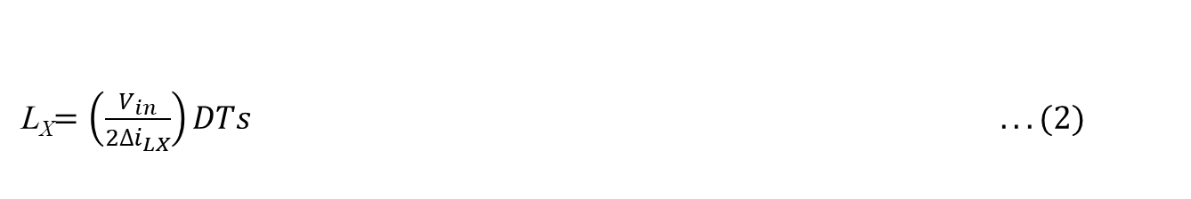
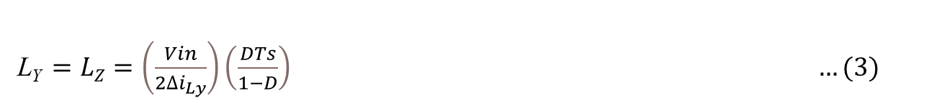
Dept. of Electrical and Electronics Engineering
Designed Equations
Voltage Gain M(D) = $\frac{V0}{Vin}= \frac{1+D}{({1−D)}^{2}} …$(1)
Inductor Equations:
Inductor L_{x} Design:
L_{X}$=\left(\frac{V_{in}}{2∆i_{LX}}\right)DTs ... (2)$
Inductor L_{y} and L_{z} Design:
L_{Y} $=LZ=\left(\frac{Vin}{2∆i_{Ly}}\right)\left(\frac{DTs}{1−D}\right) …(3)$

Slide 10
Dept. of Electrical and Electronics Engineering
Capacitor Equations:
Capacitor C_{X} design:
$$C_{x}=\frac{∆i_{LX}Ts}{8∆υ_{CX}} …(4)$$
Capacitor C_{Y} Design:
$CY=\left(\frac{Vo}{2∆υ_{o}}\right)$DTs …(5)

Slide 11
Components
Dept. of Electrical and Electronics Engineering
Component | Description | Specification
V_{in} | Input Voltage | 20V
V₀ | Output Voltage | 60V
L_{X} | Inductor | 11.33µH
L_{Y} ,L_{Z} | Inductors | 17.17µH
C_{X} | Input Capacitor | 20.83µF
C_{Y} | Output Capacitor | 34 µF
R₀ | Resistor | 1.44Ω
M(D) = V₀/V_{in} | Gain | 3
D | Duty Ratio | 0.34
F_{S} | Switching Frequency | 60000Hz
P₀ | Rated Output Power | 2500W
Table 1: Components of proposed converter

Slide 12
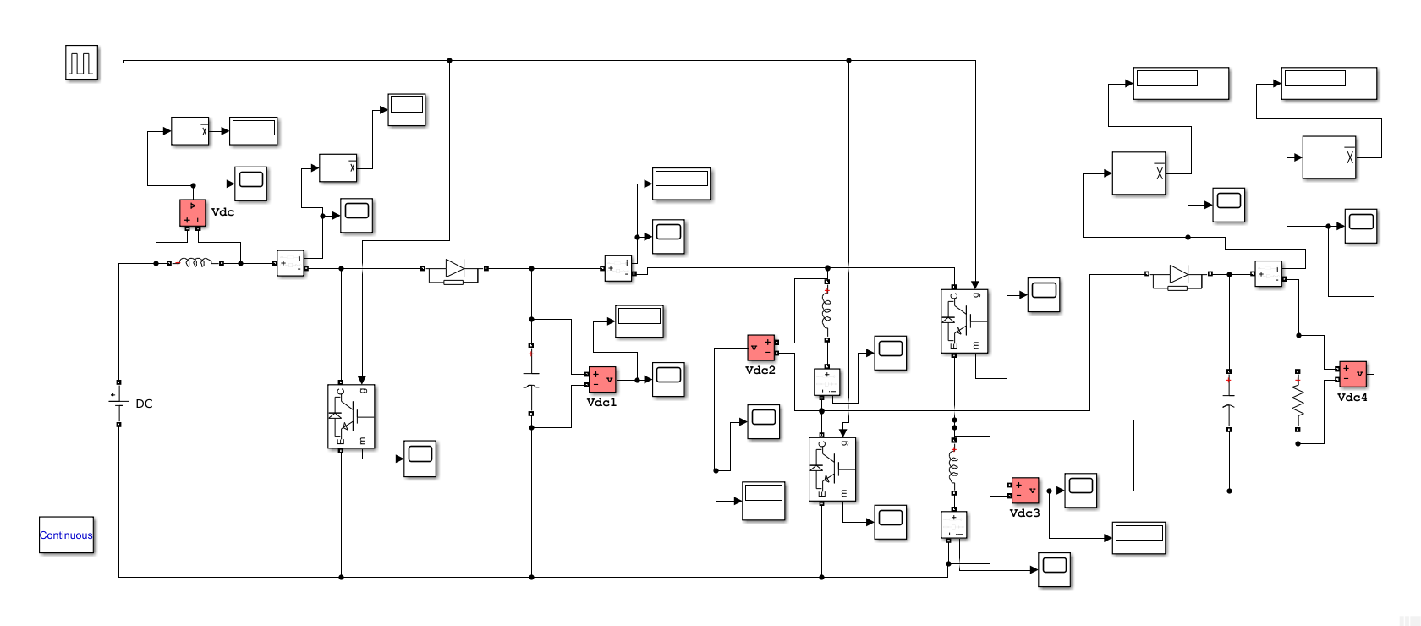
Simulink diagram
Fig.4 MATLAB simulation of proposed converter

Slide 13
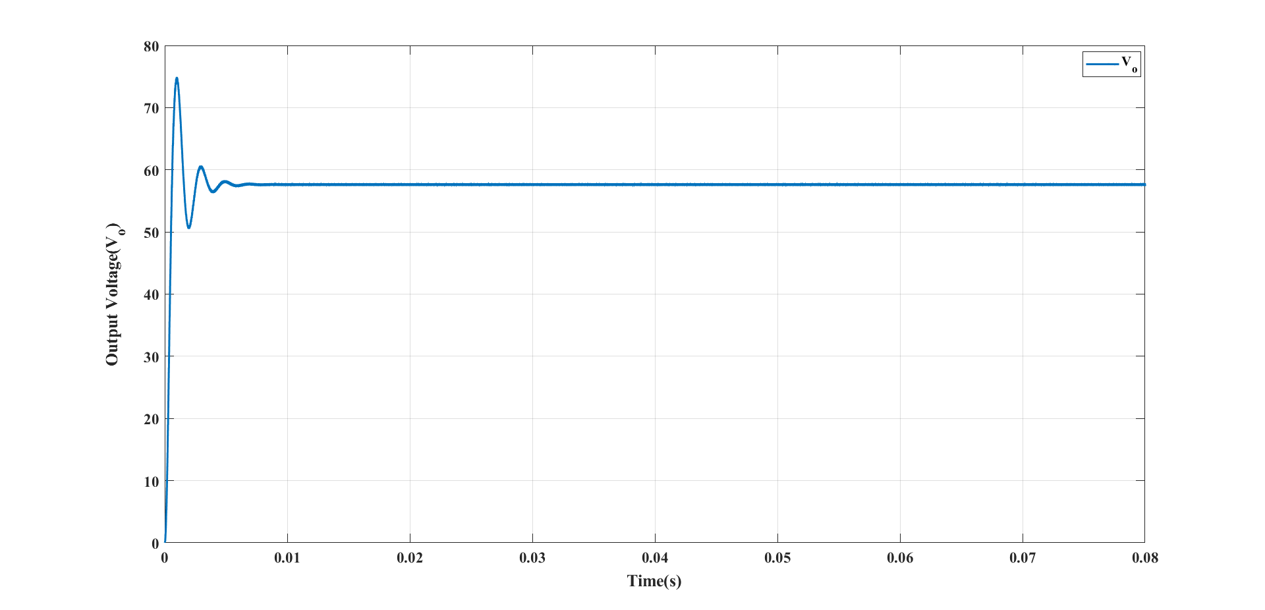
Results
Simulated Waveform of Output voltage (V₀):
Fig.5 Simulated waveform of V₀ when D=0.34 & V_{dc}=20V

Slide 14
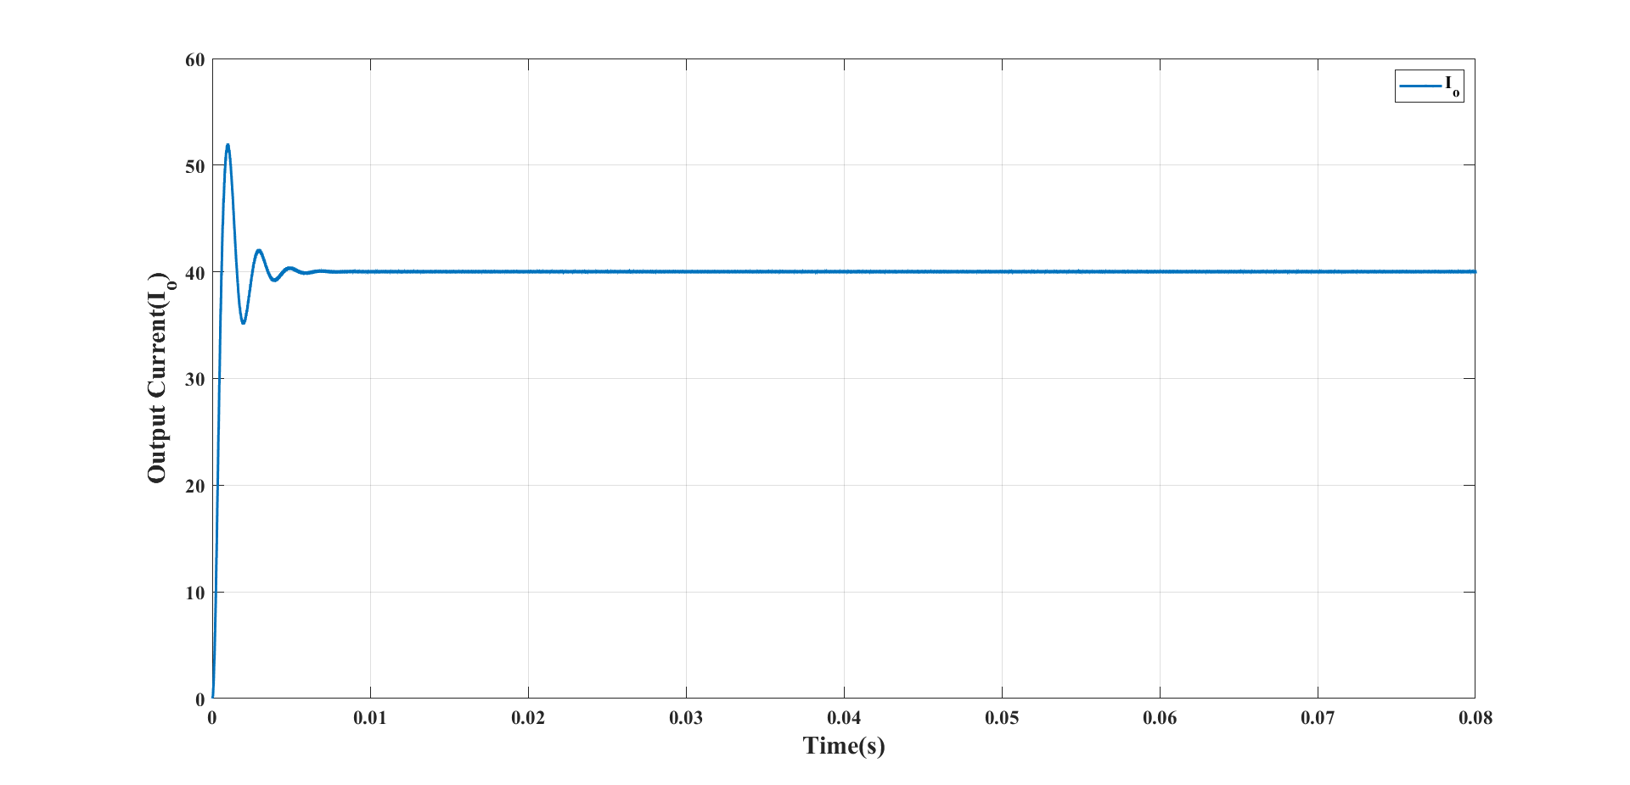
Simulated Waveform of Output current (I₀):
Dept. of Electrical and Electronics Engineering
Fig.6 Simulated waveform of I₀ when D=0.34 & V_{dc}=20V

Slide 15
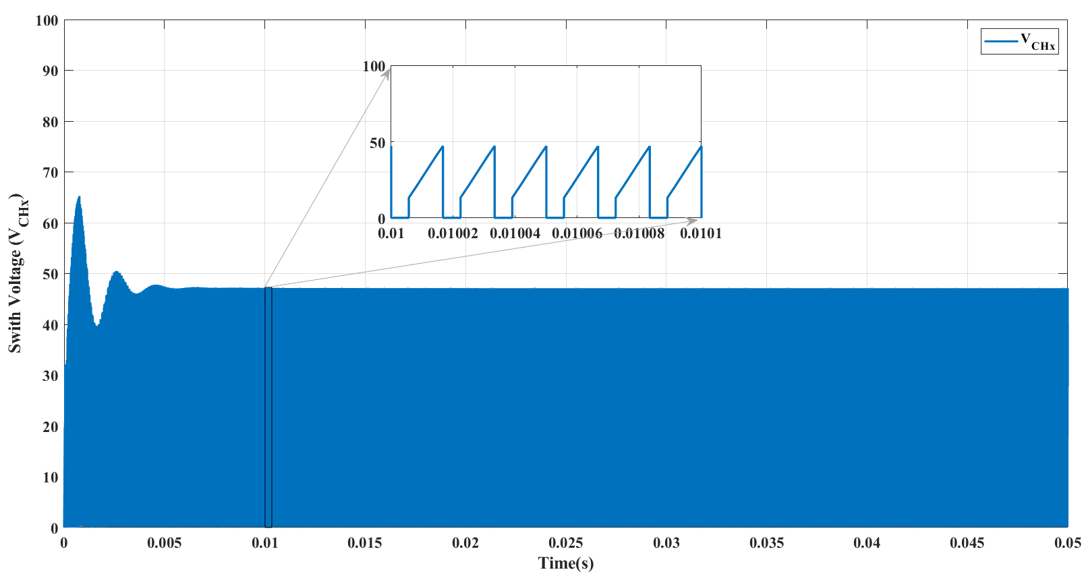
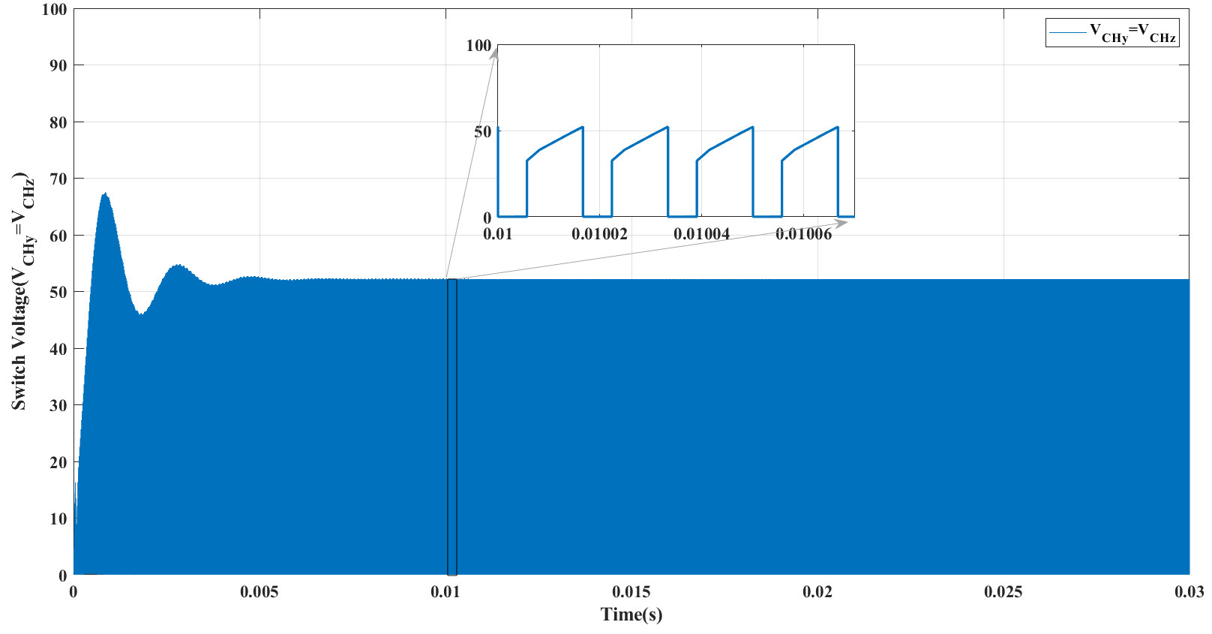
Simulated waveforms of Switch voltages (V_{CHx} , V_{CHy} , V_{CHz} ):
Dept. of Electrical and Electronics Engineering
Fig.7
Fig.8

Slide 16
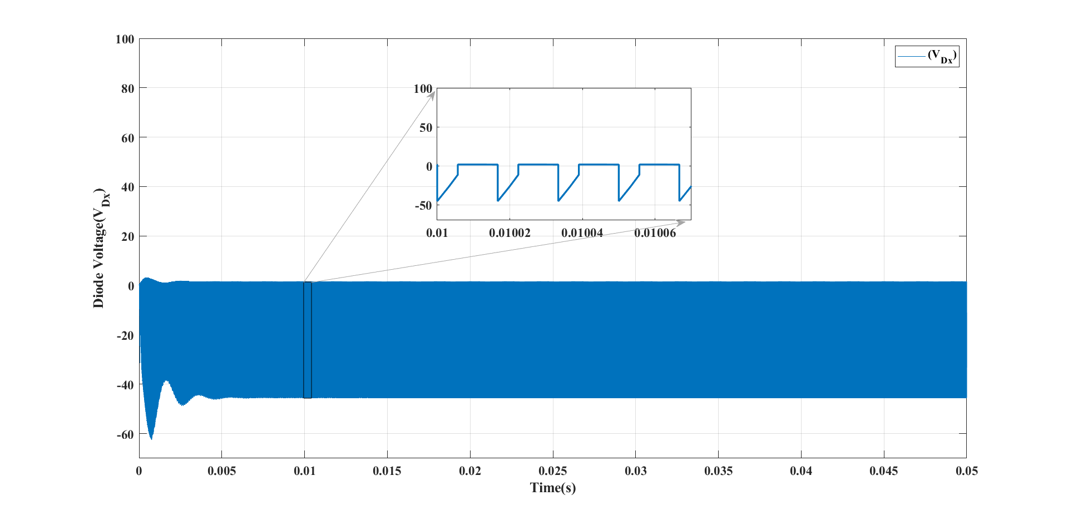
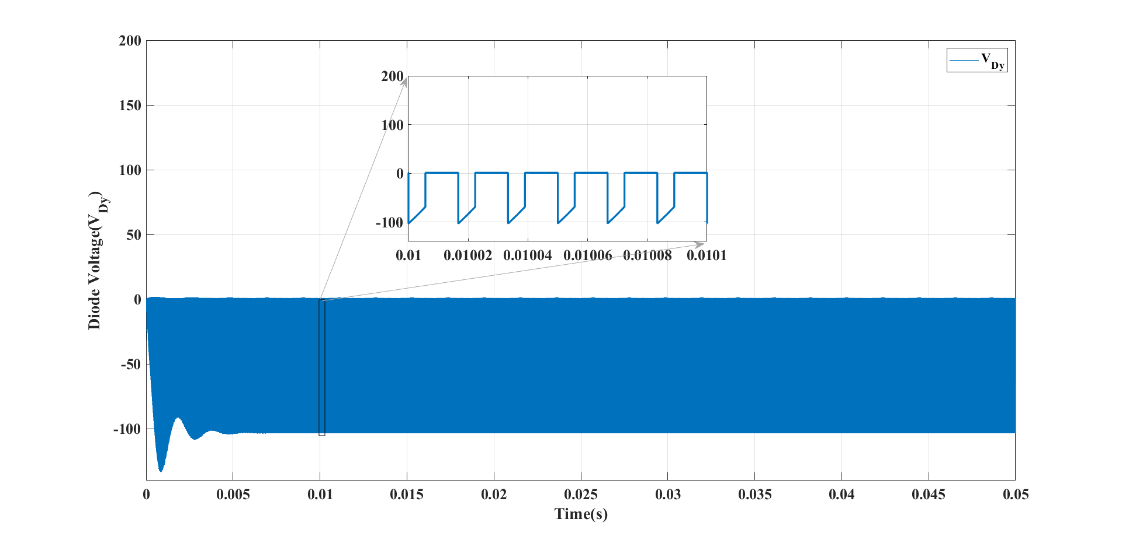
Simulated waveforms of Diode Voltages(V_{DX ,} V_{DY}):
Dept. of Electrical and Electronics Engineering
Fig.9
Fig.10

Slide 17
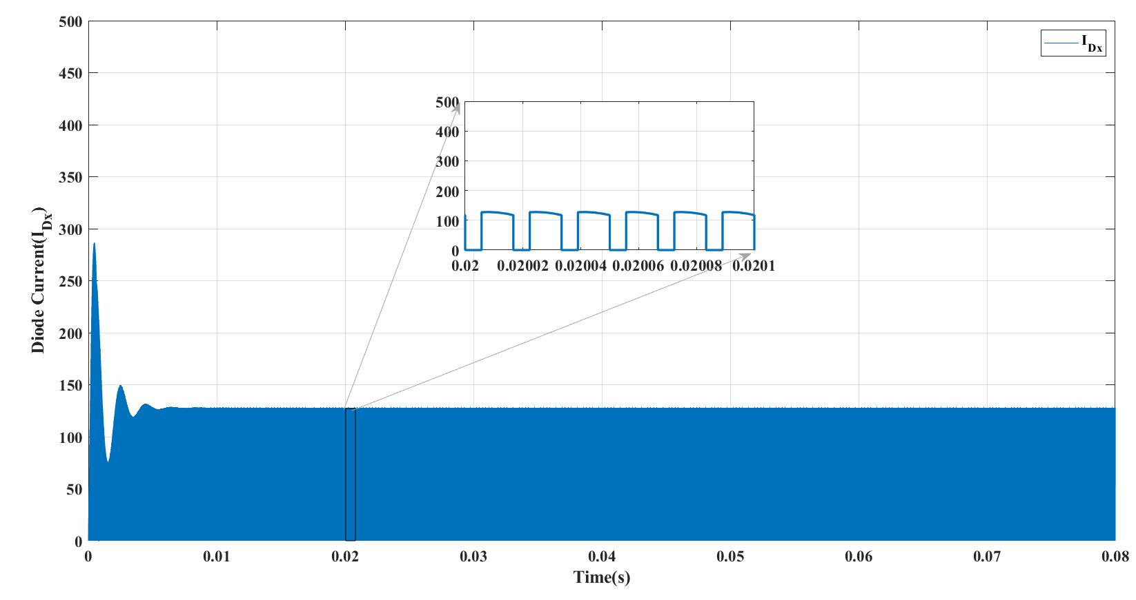
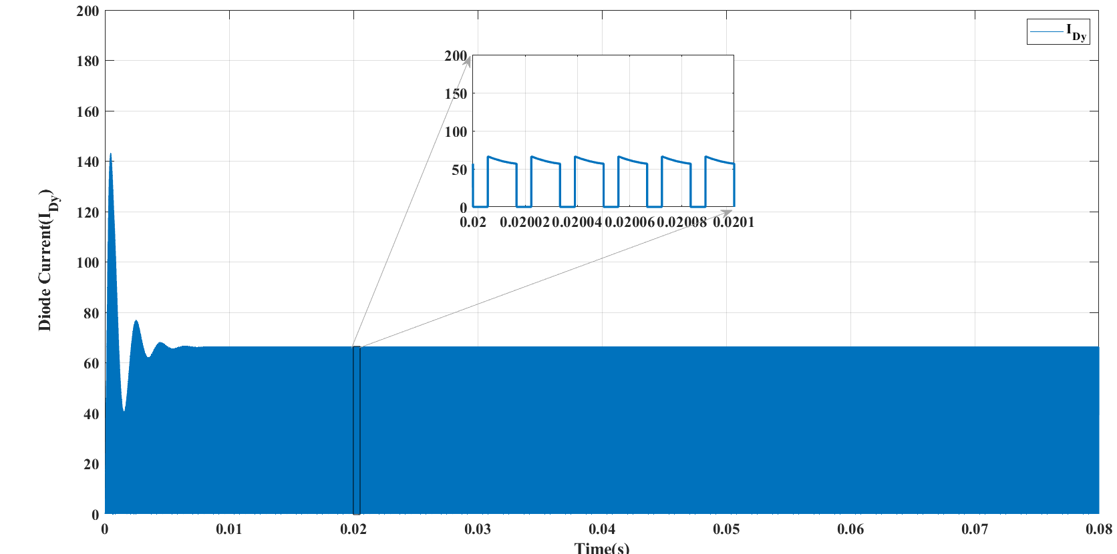
Simulated waveforms of Diode Currents (I_{DX ,} I_{DY}):
Dept. of Electrical and Electronics Engineering
Fig.11
Fig.12

Slide 18
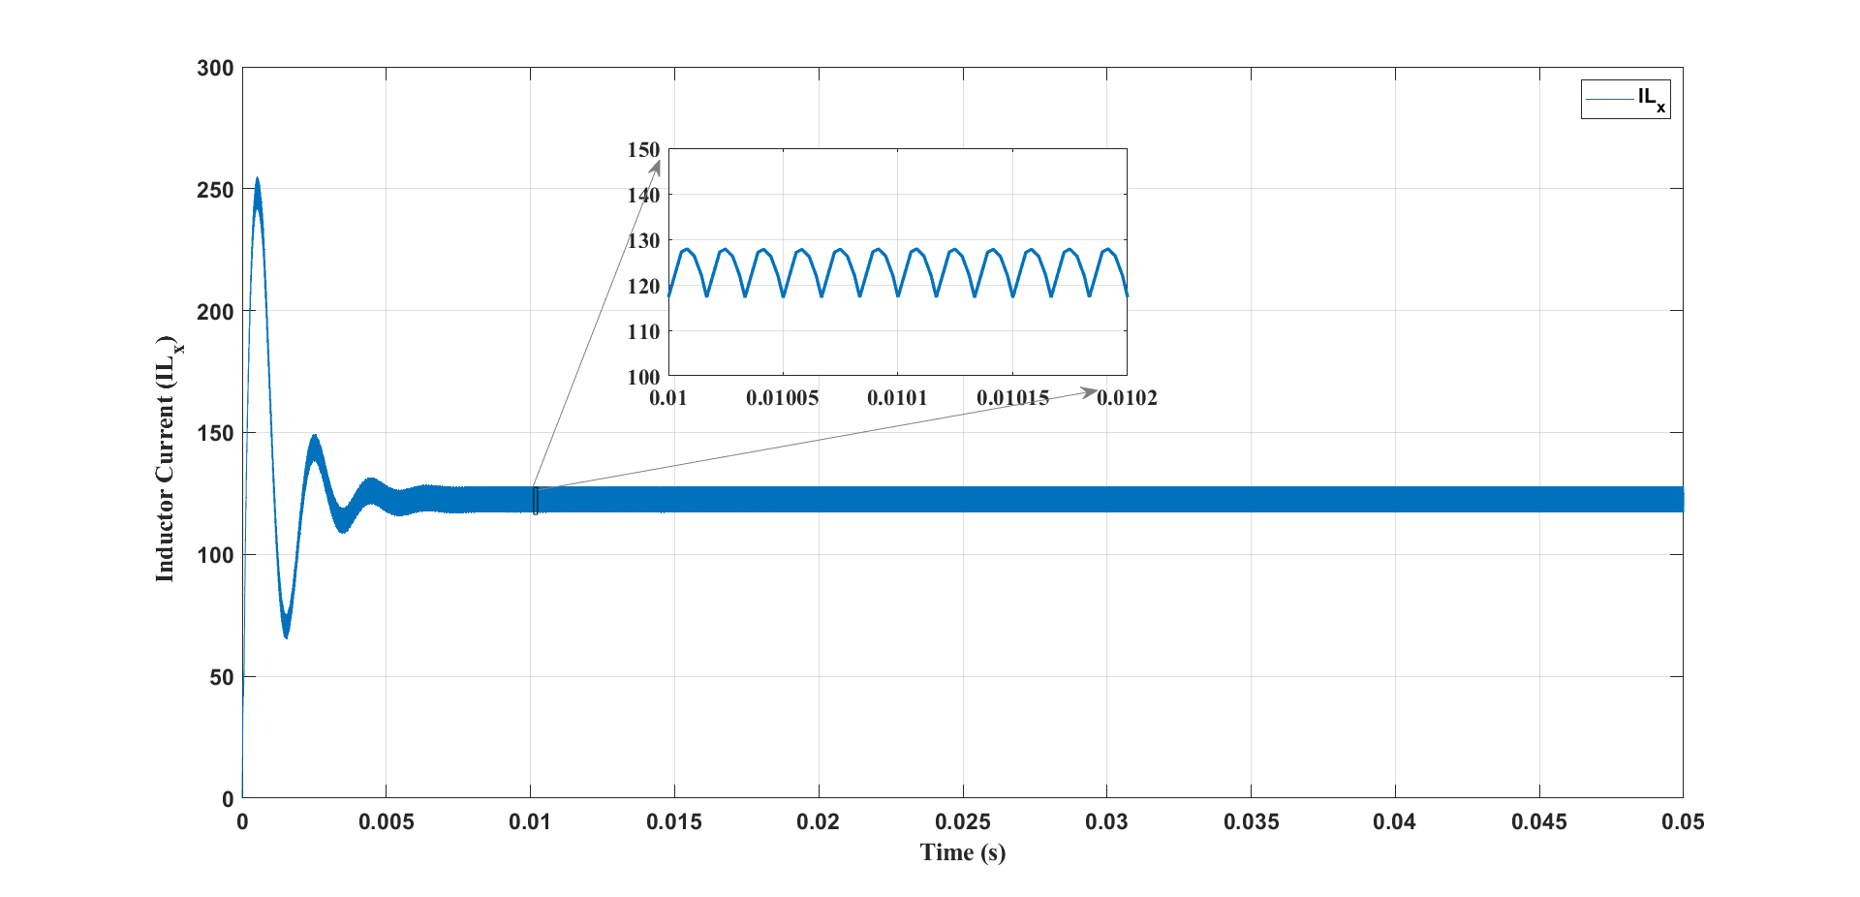
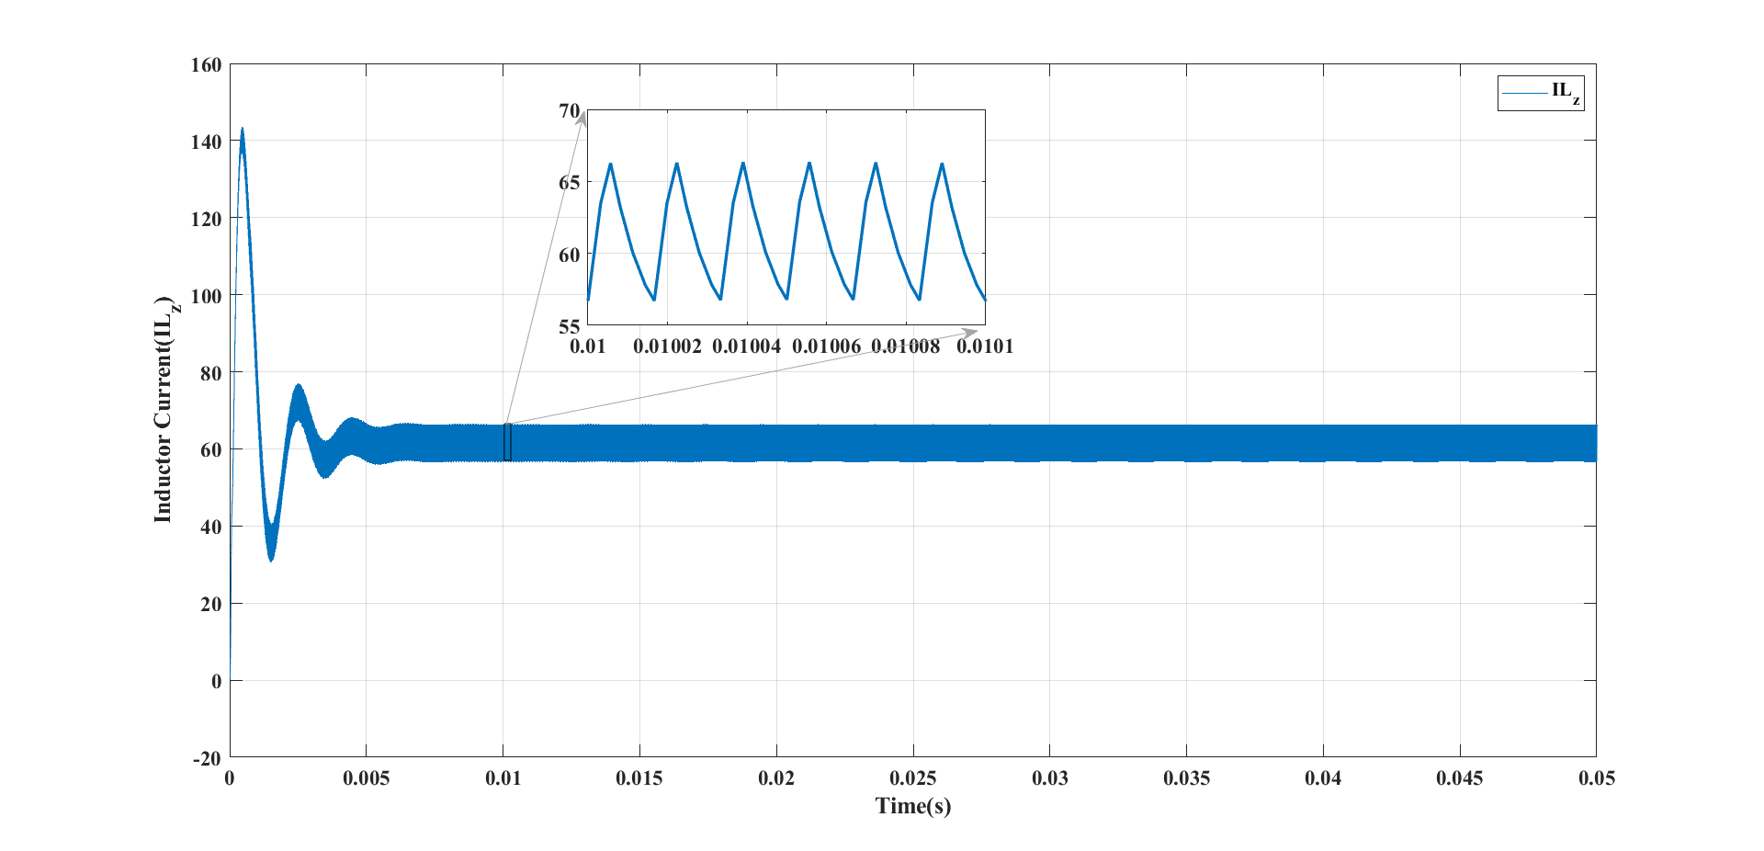
Simulated waveforms of Inductor currents (IL_{X,}IL_{Y}=IL_{Z}):
Dept. of Electrical and Electronics Engineering
Fig.13
Fig.14

Slide 19
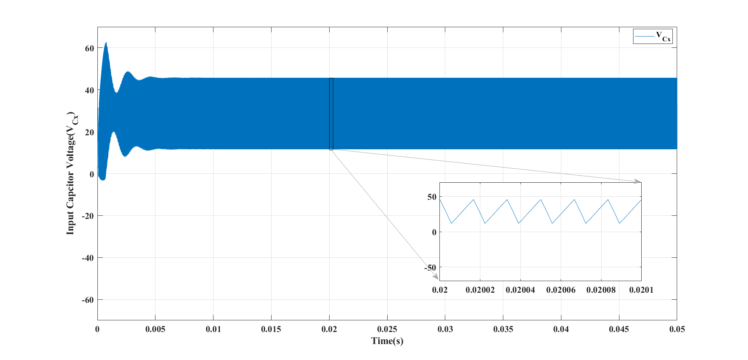
Simulated waveforms of capacitor voltage(V_{CX} ):
Dept. of Electrical and Electronics Engineering
Fig.15

Slide 20
Performance of Proposed converter:
Dept. of Electrical and Electronics Engineering
D | V_{O} | I_{o} | P_{o} | P_{in} | %η
10 | 25.9 | 18.03 | 468.23 | 489.6 | 95.6
15 | 30.38 | 21.09 | 640.71 | 671 | 95.4
20 | 35.66 | 24.77 | 883.29 | 928.4 | 95.1
25 | 42.11 | 29.25 | 1231.71 | 1301.4 | 94.6
30 | 49.97 | 34.7 | 1733.9 | 1847.6 | 93.8
34 | 57.56 | 39.97 | 2300.67 | 2476 | 92.91
35 | 59.67 | 41.44 | 2472.7 | 2668 | 92.6
40 | 71.59 | 49.72 | 3559.4 | 3912 | 90.9
45 | 82.26 | 57.12 | 4698.6 | 5276 | 89.05
50 | 89.24 | 61.98 | 5531 | 6340 | 87.7
55 | 97.34 | 67.6 | 6580.1 | 7752 | 84.8
60 | 106.9 | 74.2 | 7931.9 | 9692 | 81.8
Table 2: Performance of proposed converter

Slide 21
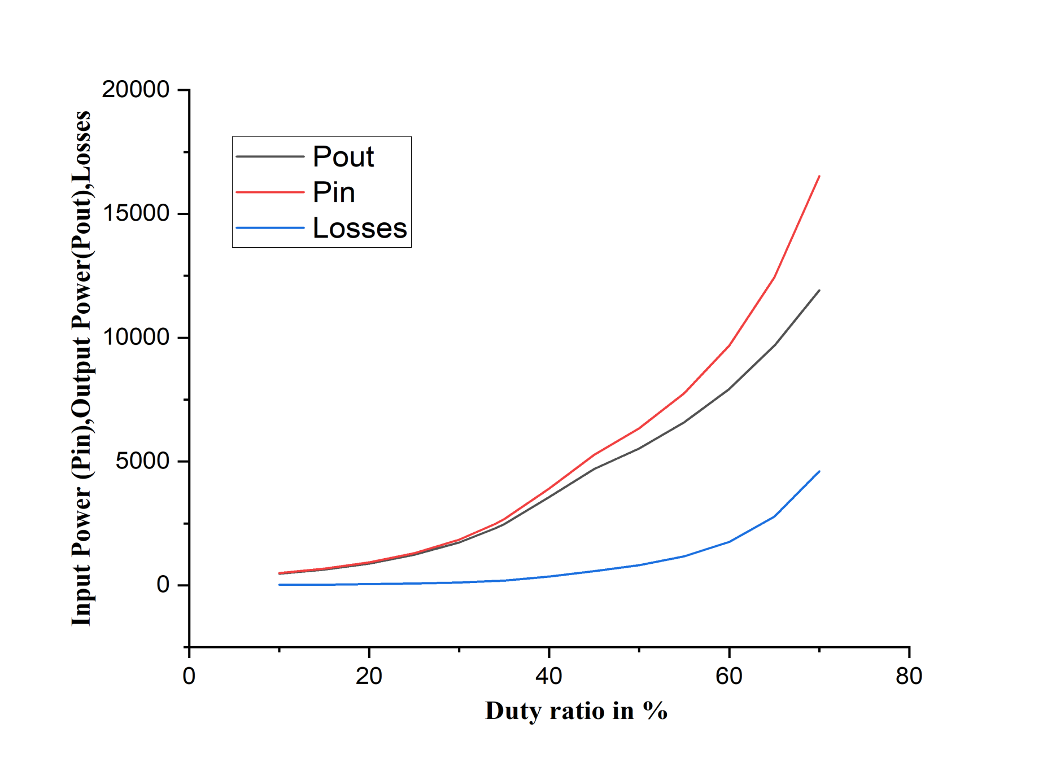
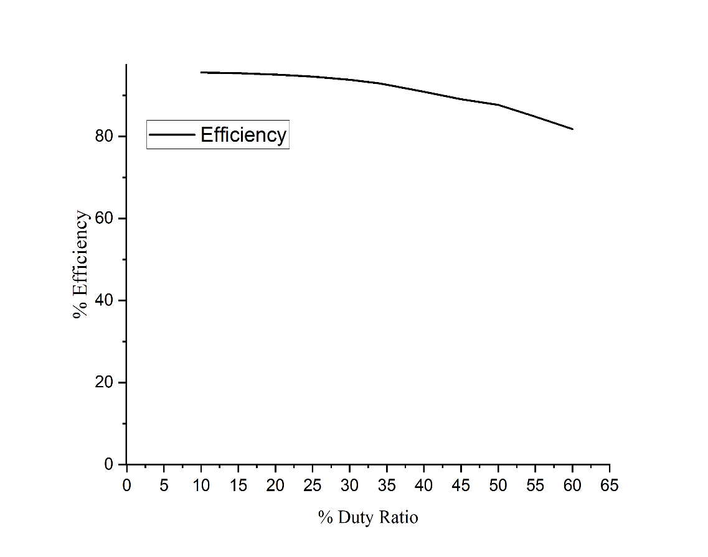
Simulated Input power, Output power, power losses curve and Efficiency Curve:
Fig.16
Fig.17

Slide 22
Switch Voltage Stresses of Proposed converter:
Dept. of Electrical and Electronics Engineering
D | V_{CHx}(Th) | V_{CHx}(si) | V_{CHy}(Th) | V_{CHy(sim)} | V_{CHz}(Th) | V_{CHz(sim)}
10 | 22.22222 | 22.28 | 24.69136 | 24.18 | 24.69136 | 24.18
15 | 23.52941 | 23.69 | 27.68166 | 26.82 | 27.68166 | 26.82
20 | 25 | 24.9 | 31.25 | 30.38 | 31.25 | 30.38
25 | 26.66667 | 26.6 | 35.55556 | 34.8 | 35.55556 | 34.8
30 | 28.57143 | 27.2 | 40.81633 | 39.8 | 40.81633 | 39.8
34 | 30.30303 | 30.35 | 45.91368 | 44.1 | 45.91368 | 44.1
35 | 30.76923 | 32.8 | 47.33728 | 45.4 | 47.33728 | 45.4
40 | 33.33333 | 35.5 | 55.55556 | 53.7 | 55.55556 | 53.7
45 | 36.36364 | 40.4 | 66.1157 | 60.7 | 66.1157 | 60.7
50 | 40 | 41.12 | 80 | 67.42 | 80 | 67.42
55 | 44.44444 | 46 | 98.76543 | 70.76 | 98.76543 | 70.76
60 | 50 | 54.4 | 125 | 77.2 | 125 | 77.2
Table 3: Comparison of theoretical and simulation values of Switch Voltage Stresses

Slide 23
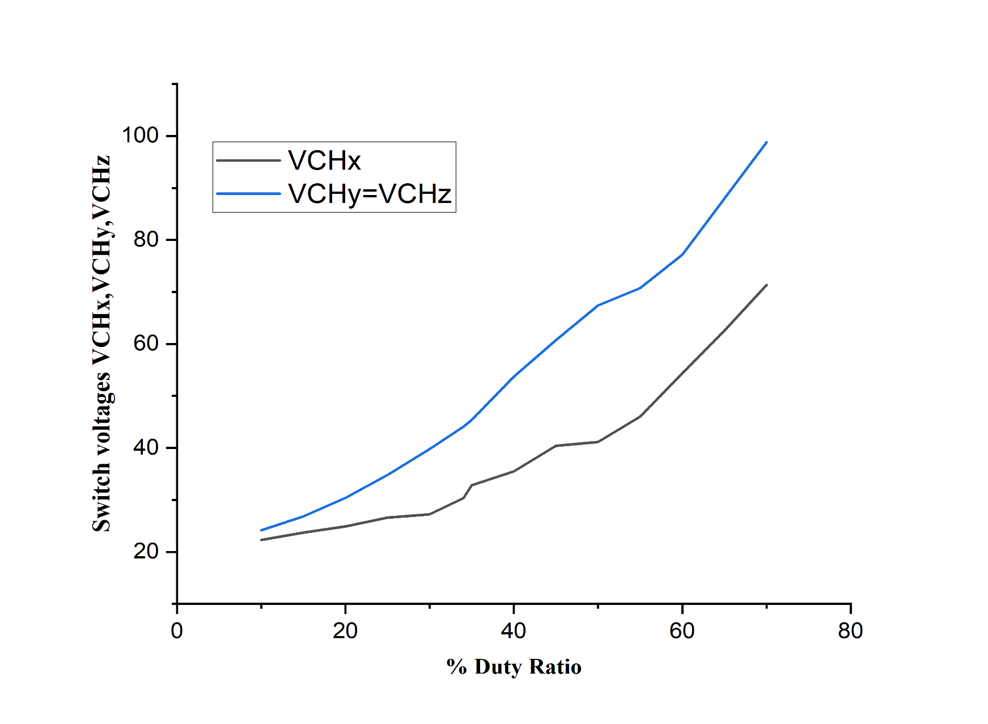
Dept. of Electrical and Electronics Engineering
Simulated Switch voltages vs Duty Ratio curve:
Fig.18

Slide 24
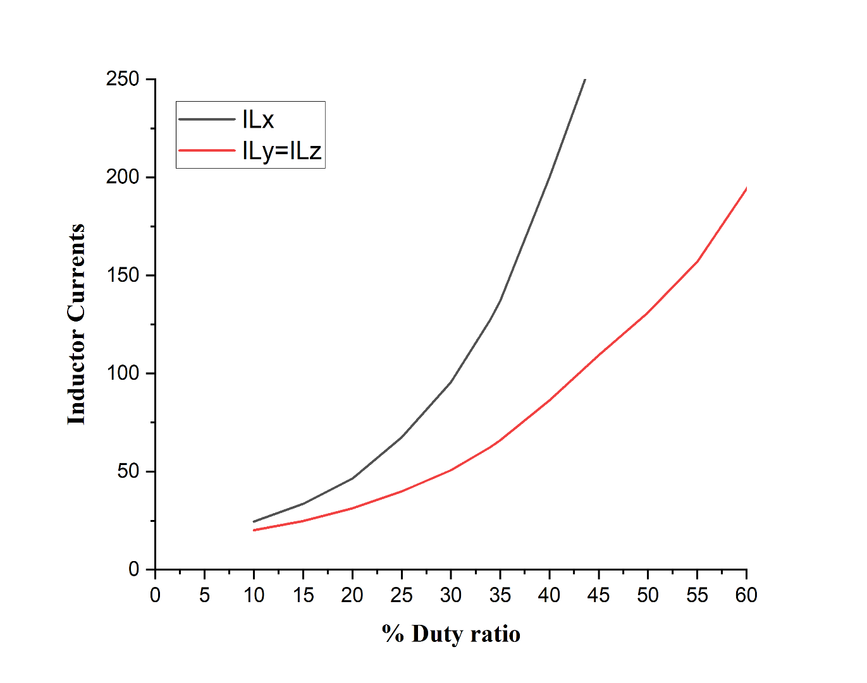
Dept. of Electrical and Electronics Engineering
Inductor Currents vs Duty Ratio curves:
D | I_{LX} | I_{LY} | I_{LZ}
10 | 24.48 | 20.11 | 20.11
15 | 33.55 | 24.83 | 24.83
20 | 46.42 | 31.25 | 31.25
25 | 67.46 | 39.88 | 39.88
30 | 95.48 | 50.75 | 50.75
34 | 127.3 | 62.4 | 62.4
35 | 137 | 65.9 | 65.9
40 | 200.1 | 86.4 | 86.4
45 | 269.3 | 109.35 | 109.35
50 | 322.8 | 131 | 131
55 | 394.1 | 157 | 157
60 | 491 | 194.1 | 194.1
Table 4: Inductor Currents
Fig.19

Slide 25
Comparison with the existing converter topologies:
S.No | Converter | Number of inductors | Number of capacitors | Number of diodes | Number of power switches | Total number of components | Voltage gain
1 | Boost | 1 | 1 | 1 | 1 | 4 | 1/ (1 − D)
2 | SL Boost | 2 | 1 | 4 | 1 | 8 | (1+D)/ (1 − D)
3 | SC Boost | 1 | 3 | 1 | 1 | 6 | 1/ (1 − D)
4 | Non-isolated bidirectional DC-DC converter | 2 | 3 | 0 | 4 | 9 | 1/(1-D)^2
5 | A New High-Gain DC-DC Converter [24] | 2 | 2 | 2 | 2 | 8 | (1+D- 𝐷^2 )/(1 − 𝐷)^2
6 | An interleaved boost DC-DC converter [25] | 2 | 3 | 4 | 2 | 11 | 2/ (1 − D)
7 | Non-isolated high step-up DC–DC converters | 2 | 5 | 4 | 1 | 12 | (2+D)/ (1 − D)
8 | Single Switch High Step-Up DC–DC Converter [26] | 2 | 3 | 1 | 4 | 10 | (3+D)/2 (1 − D)
9 | Ultra voltage gain boost converter | 3 | 2 | 2 | 3 | 10 | (1+D)/(1 − 𝐷)^2
Table 5: Comparison with existing converter topologies

Slide 26
Comparison of Voltage Gain values with existing Converter topologies:
D | Boost | SL Boost | SC Boost | Dual- Switch High- Boost DC– DC Converter | Non-isolated Bidirectional DC- DC converter [23] | A New High- Gain DC- DC Converter [24] | An Interleaved boost DC- DC converter [25] | Single Switch High Step- Up DC– DC Converter [26] | Ultra voltage gain boost converter
10 | 22.22 | 24.44 | 22.22 | 70 | 24.69 | 26.91 | 46.66 | 34.44 | 27.16
15 | 23.52 | 27.05 | 23.52 | 77.14 | 27.68 | 31.21 | 50.58 | 37.05 | 31.83
20 | 25 | 30 | 25 | 86.66 | 31.25 | 36.25 | 55 | 40 | 37.5
25 | 26.66 | 33.33 | 26.66 | 100 | 35.55 | 42.22 | 60 | 43.33 | 44.44
30 | 28.5 | 37.1 | 28.5 | 120 | 40.81 | 49.38 | 65.71 | 47.14 | 53.06
34 | 30.3 | 40.6 | 30.3 | 145 | 45.91 | 56.21 | 70.9 | 50.6 | 61.52
35 | 30.7 | 41.5 | 30.7 | 153.33 | 47.33 | 58.1 | 72.3 | 51.53 | 63.9
40 | 33.33 | 46.6 | 33.3 | 220 | 55.55 | 68.88 | 80 | 56.66 | 77.77
45 | 36.3 | 52.7 | 36.3 | 420 | 66.11 | 82.47 | 89.09 | 62.72 | 95.86
50 | 40 | 60 | 40 | In | 80 | 100 | 100 | 70 | 120
55 | 44.4 | 68.8 | 44.4 | -380 | 98.76 | 123.2 | 113.33 | 78.88 | 153.08
60 | 50 | 80 | 50 | -180 | 125 | 155 | 130 | 90 | 200
Table 6: Comparison of Voltage Gain

Slide 27
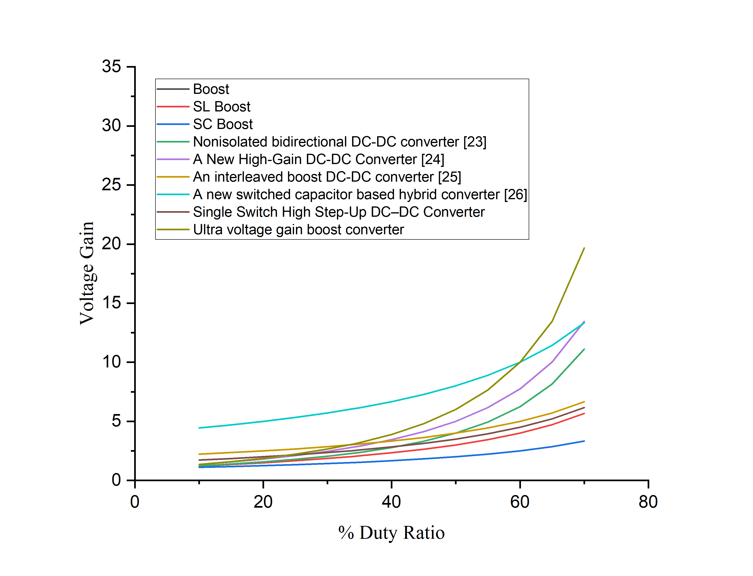
Comparison of Voltage Gain curves with existing converter topologies:
Fig.20

Slide 28
Comparison of Output Voltage values with existing converter topologies:
D | Boost | SL Boost | SC Boost | Dual- Switch High- Boost DC– DC Converter | Non-isolated Bidirectional DC- DC converter [23] | A New High- Gain DC- DC Converter [24] | An Interleaved boost DC- DC converter [25] | Single Switch High Step- Up DC– DC Converter [26] | Ultra voltage gain boost converter
10 | 22.22 | 24.44 | 22.22 | 70 | 24.69 | 26.91 | 46.66 | 34.44 | 27.16
15 | 23.52 | 27.05 | 23.52 | 77.14 | 27.68 | 31.21 | 50.58 | 37.05 | 31.83
20 | 25 | 30 | 25 | 86.66 | 31.25 | 36.25 | 55 | 40 | 37.5
25 | 26.66 | 33.33 | 26.66 | 100 | 35.55 | 42.22 | 60 | 43.33 | 44.44
30 | 28.5 | 37.1 | 28.5 | 120 | 40.81 | 49.38 | 65.71 | 47.14 | 53.06
34 | 30.3 | 40.6 | 30.3 | 145 | 45.91 | 56.21 | 70.9 | 50.6 | 61.52
35 | 30.7 | 41.5 | 30.7 | 153.33 | 47.33 | 58.1 | 72.3 | 51.53 | 63.9
40 | 33.33 | 46.6 | 33.3 | 220 | 55.55 | 68.88 | 80 | 56.66 | 77.77
45 | 36.3 | 52.7 | 36.3 | 420 | 66.11 | 82.47 | 89.09 | 62.72 | 95.86
50 | 40 | 60 | 40 | In | 80 | 100 | 100 | 70 | 120
55 | 44.4 | 68.8 | 44.4 | -380 | 98.76 | 123.2 | 113.33 | 78.88 | 153.08
60 | 50 | 80 | 50 | -180 | 125 | 155 | 130 | 90 | 200
Table 7: Comparison of output voltages

Slide 29
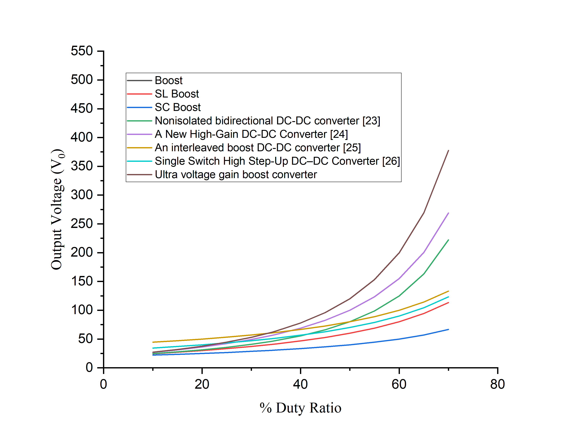
Comparison of Output Voltage curves with existing topologies:
Fig.21

Slide 30
Observations from the Results
The performance of the proposed converter in continuous current mode for steady state condition is analyzed.
From the simulation results, it can be observed that the proposed boost converter produces high voltage gain even for small duty ratios also (see fig.19).
The voltage and the current stresses of the proposed converter are lower when compared with the existing topologies. Therefore, the efficiency of the proposed converter is high for various duty ratios (see in Table 2).
Higher voltages with low ripple value is obtained (see in Table 3).

Slide 31
Conclusions
The purpose of this project was to develop a new dc/dc boost configuration with high voltage-gain capability for fuel cell converters.
The developed configuration consisted of three switches, two diodes, and three inductors.
A theoretical analysis of the converter demonstrated its high voltage-gain, low voltage and current stress on its devices, and high efficiency.
The simulation results obtained were consistent with the theoretical analysis of the converter.

Slide 32
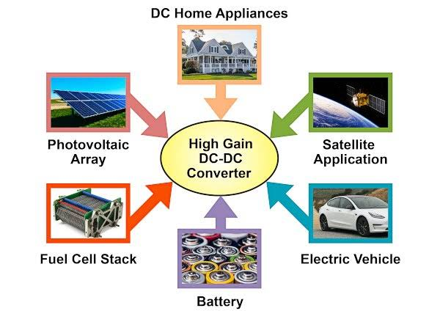
Applications

Slide 33
Future scope
The proposed converter has the features like increasing step-up gain voltage, continuous input current, increasing efficiency and less number of components.
Hence perfectly suitable for fuel cell system, photovoltaic applications and Electric vehicle applications.

Slide 34
References
[1] Zaid, M.; Lin, C.-H.; Khan, S.; Ahmad, J.; Tariq, M.; Mahmood, A.; Sarwar, A.; Alamri, B.; Alahmadi, A. “ Family of transformerless quadratic boost high gain dc-dc converters”.Energies 2021, 14, 4372. [CrossRef]
[2] Barbosa, E.A.O.; Carvalho, M.R.S.D.; Rodrigues Limongi, L.; Cavalcanti, M.C.; Barbosa, E.J.; Azevedo, G.M.D.S. “High-gain high-efficiency dc–dc converter with single-core parallel operation switched inductors and rectifier voltage multiplier cell”. Energies 2021, 14, 4634. [CrossRef]
[3] Pereira, A.V.C.; Cavalcanti, M.C.; Azevedo, G.M.; Bradaschia, F.; Neto, R.C.; Carvalho, M.R.S.D."A novel single-switch high step-up dc–dc converter with threewinding coupled inductor”. Energies 2021, 14, 6288. [CrossRef]
[4] Souza, L.C.; Morais, D.C.; Silva, L.D.S.D.C.E.; Seixas, F.J.M.D.; Arenas, L.D.O. “DC-DC 3SSC-a-based boost converter: Analysis, design, and experimental validation”. Energies 2021, 14, 6771. [CrossRef]
[5] Gholizadeh, H.; Gorji, S.A.; Afjei, E.; Sera, “D. Design and implementation of a new cuk-based step-up DC–DC converter”. Energies 2021, 14, 6975. [CrossRef]
[6] Chub, A.; Vinnikov, D.; Blaabjerg, F.; Peng, F.Z. “A review of galvanically isolated impedance-source DC-DC converters”. IEEE Trans. Power Electron. 2016, 31, 2808– 2828. [CrossRef]
[7] Abdel-Rahim, O.; Chub, A.; Blinov, A.; Vinnikov, D. “New high-gain noninverting buck-boost converter”. In Proceedings of the IECON 2021–47th Annual Conference of the IEEE Industrial Electronics Society, Toronto, ON, Canada, 13 October 2021; pp. 1–6.
[8]. Ojeda-Rodríguez, Á.; González-Vizuete, P.; Bernal-Méndez, J.; Martín-Prats, M.A. “A survey on bidirectional dc/dc power converter topologies for the future hybrid and all electric aircrafts”. Energies 2020, 13, 4883. [CrossRef]
[9] De Souza, A.F.; Tofoli, F.L.; Ribeiro, E.R. Switched capacitor dc-dc converters: A survey on the main topologies, design characteristics, and applications. Energies 2021, 14, 2231. [CrossRef]
[10]. Forouzesh, M.; Siwakoti, Y.P.; Gorji, S.A.; Blaabjerg, F.; Lehman, B. Step-up DC-DC converters: A comprehensive review of voltage-boosting techniques, topologies, and applications. IEEE Trans. Power Electron. 2017, 32, 9143–9178. [CrossRef] FUEL CELL BASED ULTRA-VOLTAGE GAIN BOOST CONVERTER FOR ELECTRIC VEHICLE APPLICATIONS VBIT-EEE Page 42
[11]. Andrade, A.M.S.S.; Martins, M.L.D.S. “Quadratic-boost with stacked zeta converter for high voltage gain applications”. IEEE J. Emerg. Sel. Top. Power Electron. 2017, 5, 1787–1796. [CrossRef]
[12]. Ai, J.; Lin, M. “Ultra large gain step-up coupled-inductor dc-dc converter with an asymmetric voltage multiplier network for a sustainable energy system”. IEEE Trans. Power Electron. 2017, 32, 6896–6903. [CrossRef]
[13] Zhang, Y.; Gao, Y.; Zhou, L.; Sumner, M. “A switched-capacitor bidirectional dcdc converter with wide voltage gain range for electric vehicles with hybrid energy sources”. IEEE Trans. Power Electron. 2018, 33, 9459–9469. [CrossRef]

Slide 35
[14] Axelrod, B.; Berkovich, Y.; Ioinovici, A. Switched-capacitor/switched-inductor structures for getting transformerless hybrid DC–DC pwm converters. IEEE Trans. Circuits Syst. 2008, 55, 687–696. [CrossRef]
[15] Young, C.-M.; Chen, M.-H.; Chang, T.-A.; Ko, C.-C.; Jen, K.-K. Cascade Cockcroft–Walton Voltage Multiplier Applied to Transformerless High Step-Up DC– DC Converter. IEEE Trans. Ind. Electron. 2013, 60, 523–537. [CrossRef]
[16] Andrade, A.M.S.S.; Hey, H.L.; Schuch, L.; da Silva Martins, M.L. Comparative Evaluation of Single Switch High-Voltage Step-Up Topologies Based on Boost and Zeta PWM Cells. IEEE Trans. Ind. Electron. 2018, 65, 2322–2334. [CrossRef]
[17] De Paula, W.J.; Júnior, D.D.O.; Pereira, D.D.; Tofoli, F.L. “Survey on non-isolated high-voltage step-up dc–dc topologies based on the boost converter”. IET Power Electron. 2015, 8, 2044–2057
[18] Waradzyn, Z.; Stala, R.; Mondzik, A.; Penczek, A.; Skala, A.; Pirog, S. “Efficiency Analysis of MOSFET-Based Air-Choke Resonant DC–DC Step-Up SwitchedCapacitor Voltage Multipliers”. IEEE Trans. Ind. Electron. 2017, 64, 8728–8738. [CrossRef]
[19] Cervera, A.; Evzelman, M.; Peretz, M.M.; Ben-Yaakov, S. “A high-efficiency resonant switched capacitor converter with continuous conversion ratio”. IEEE Trans. Power Electron. 2015, 30, 1373–1382. [CrossRef]
[20] Stala, R.; Waradzyn, Z.; Mondzik, A.; Penczek, A.; Skała, “A. DC–DC high stepup converter with low count of switches based on resonant switched-capacitor topology”. In Proceedings of the 2019 21st European Conference on Power Electronics and Applications (EPE’19 ECCE Europe), Genova, Italy, 2–5 September 2019; pp. P.1–P.10. FUEL CELL BASED ULTRA-VOLTAGE GAIN BOOST CONVERTER FOR ELECTRIC VEHICLE APPLICATIONS VBIT-EEE Page 43
[21] Shoyama, M.; Naka, T.; Ninomiya, T. “Resonant switched capacitor converter with high efficiency”. In Proceedings of the 2004 IEEE 35th Annual Power Electronics Specialists Conference 2004, Aachen, Germany, 20–25 June 2004; Volume 5, pp. 3780–3786. [CrossRef]
[22] Kesarwani, K.; Sangwan, R.; Stauth, J.T. “Resonant-switched capacitor converters for chip-scale power delivery: Design and implementation”. IEEE Trans. Power Electron. 2015, 30, 6966–6977. [CrossRef]
[23] Ardi, H.; Ajami, A.; Kardan, F.; Avilagh, S.N. “Analysis and implementation of a non-isolated bidirectional DC-DC converter with high voltage gain”. IEEE Trans. Ind. Electron. 2016, 63, 4878–4888.
[24] Ahmad, J.; Zaid, M.; Sarwar, A.; Lin, C.-H.; Asim, M.; Yadav, R.K.; Tariq, M.; Satpathi, K.; Alamri, B. “A New High-Gain DC-DC Converter with Continuous Input Current for DC Microgrid Applications”. Energies 2021, 14, 2629. [CrossRef]
[25] R. Gules, L. L. Pfitscher, and L. C. Franco, “An interleaved boost DC-DC converter with large conversion ratio,” in Proc. IEEE Int. Symp. Ind. Electron., 2003, pp. 411–416.
[26] Saravanan, S., & Babu, N. R. (2018). “Design and Development of Single Switch High Step-Up DC–DC Converter”. IEEE Journal of Emerging and Selected Topics in Power Electronics, 6(2), 855–863. doi:10.1109/jestpe.2017.2739819

Slide 36
Queries

Slide 37

THANK YOU

